Slide 1

TITLE

Slide 2
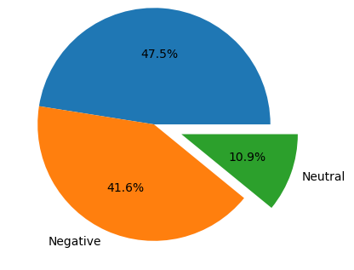

Insights from Customer reviews
From cleaning 1000 reviews given by the customers, we obtained
Positive Reviews - 475
Negative Reviews - 416
Neutral Reviews – 109

